Slide 1
Slang Embedded Systems Interfacing
Jacob Legg

Slide 2

Review
Design a tools for educational and industrial use
Allow for behavior code to semantically verified and written in a high-level language
Allow for a plug-and-play design for user interfaces with read-write semantics

Slide 3
Device1
State Machine
/ Device Bridge
Device2
Abstract
BOARD
Defined Board Implementation
…
DeviceN

Slide 4
Device1
Logical Pin 1
Architecture Implementation
State Machine
/ Device Bridge
Device2
Logical Pin 2
Abstract
Architecture Controller
Defined
Architecture Controller
…
…
DeviceN
Logical Pin n

Slide 5
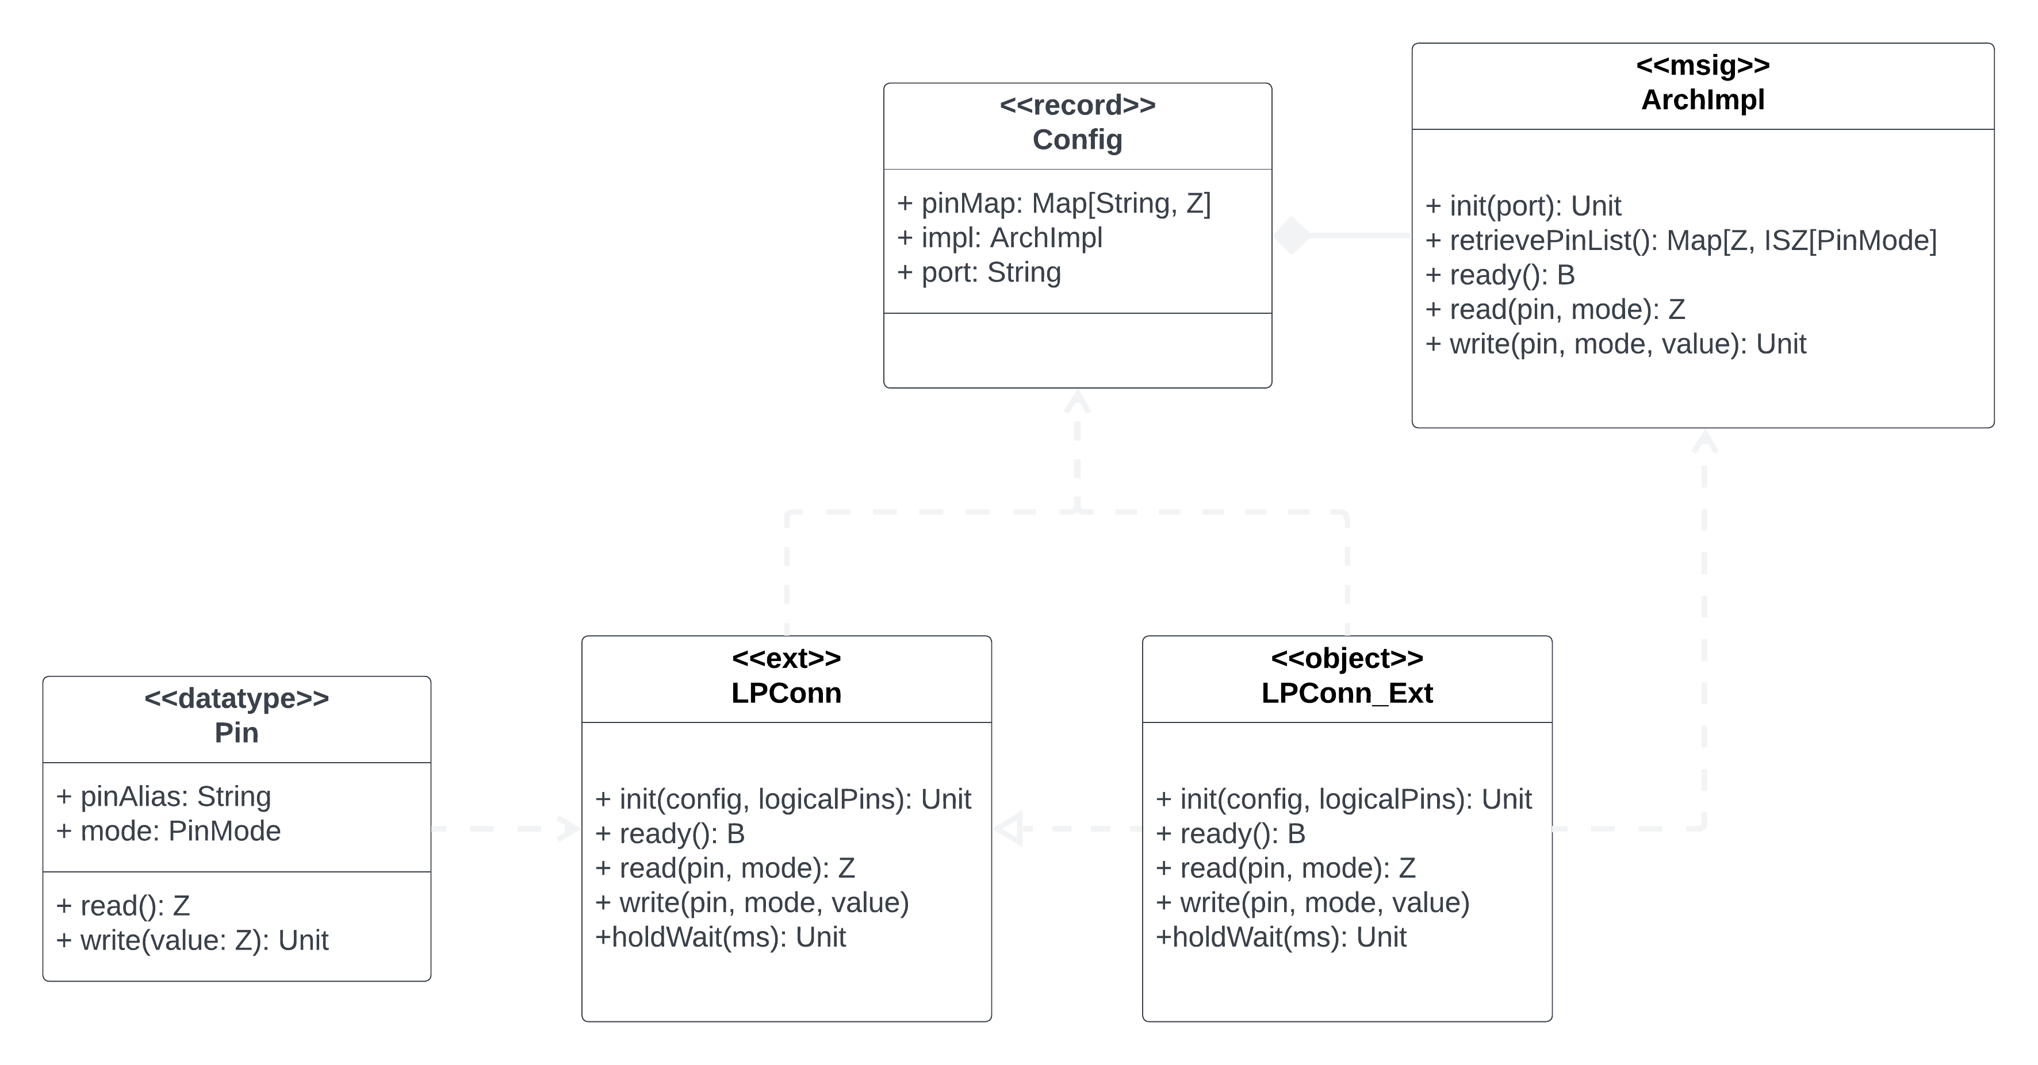

Slide 6
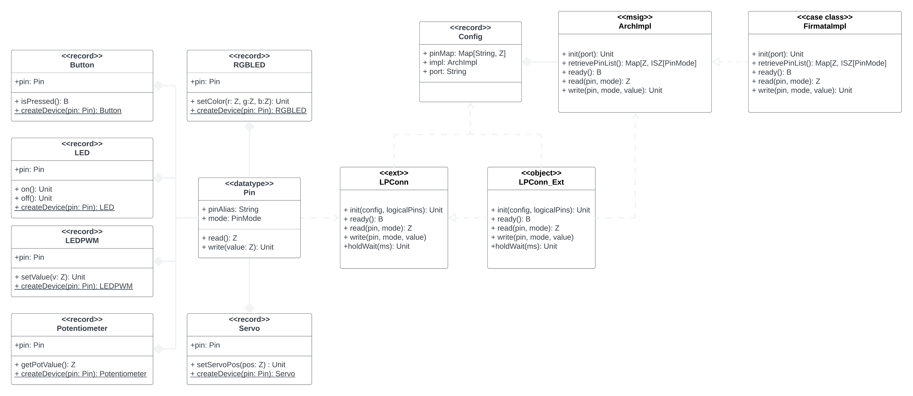

Slide 7
Architecture Testing Strategies
Fully Simulated
(White Box)
Inputs Simulated
(Gray Box)
No Simulation
(Black Box)
Simulated Inputs
Simulated Outputs
Testing pass through of logical architecture
Simulated Inputs
Physical Outputs
Testing writing output to physical architecture correctly
Physical Inputs
Physical Outputs
Testing reading in inputs
Testing full pass through of the entire physical and logical architecture

Slide 8

Educational Testing
Practice Assignments
Teacher Designed Assignments
Provide students who have never used the tool an assignment
See if they are getting stuck on the tool
Testing ease of use for new users
Provide teacher with the tool to design an assignment
Testing the usability of the tool for teachers
Testing the ease of adding new devices and physical implementations

Slide 9

Timeline
Oct 30: 2nd Presentation
Nov 11: Rough-Draft Code Complete
Nov 18: Rough-Draft Documentation Complete
Nov 26: Abstract and Advertisement
Dec 1: Version 1.0 Complete
Dec 8: Submit Final Materials

Slide 10



Questions?
Updated Design
UML
Testing Strategies

